Slide 1
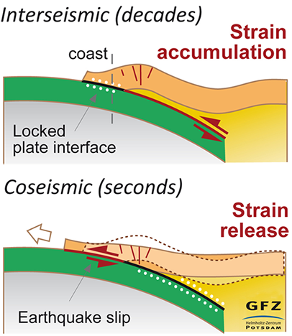
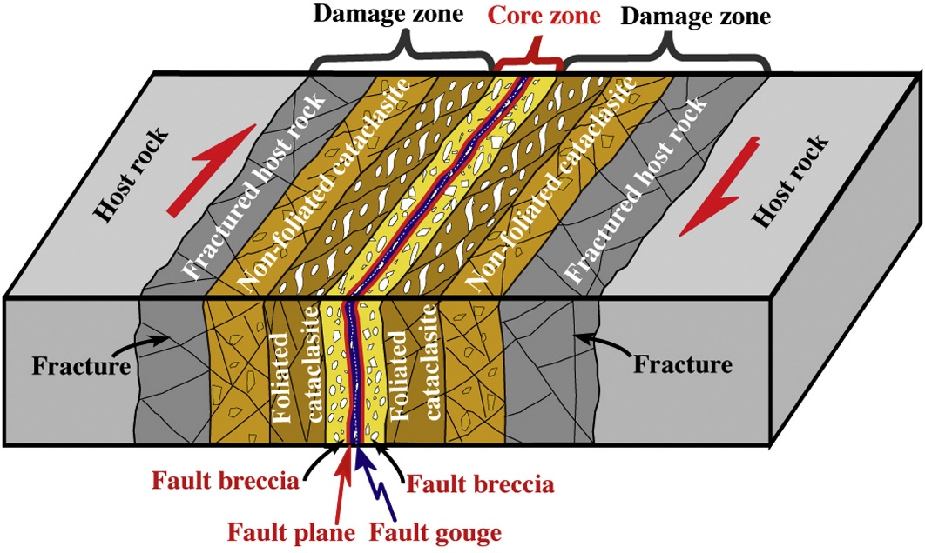
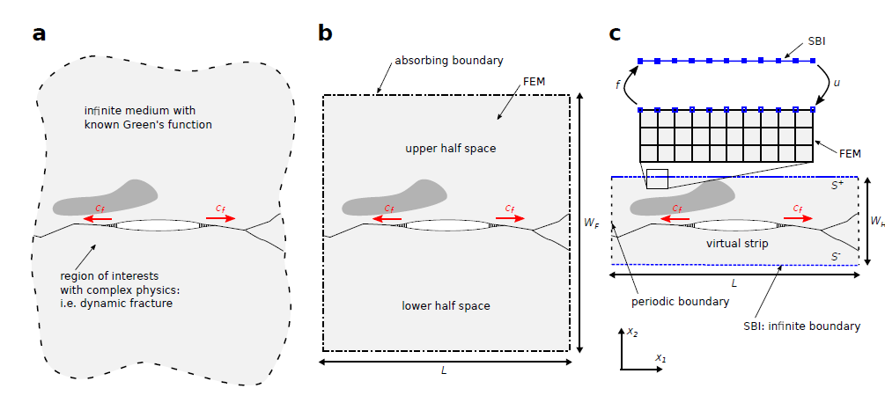
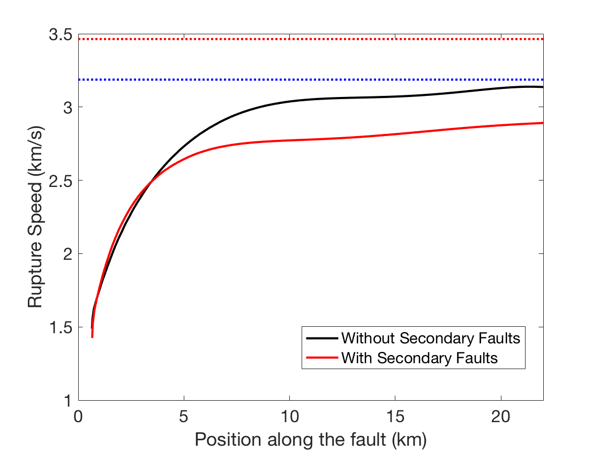
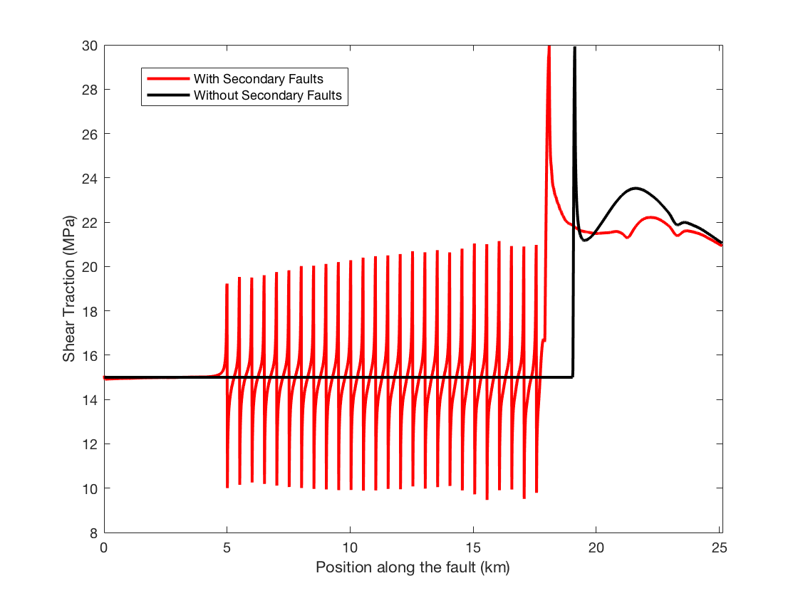
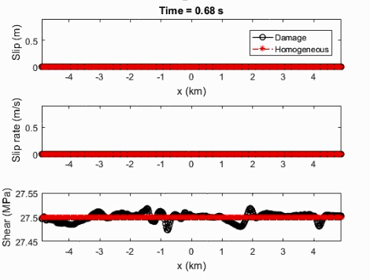
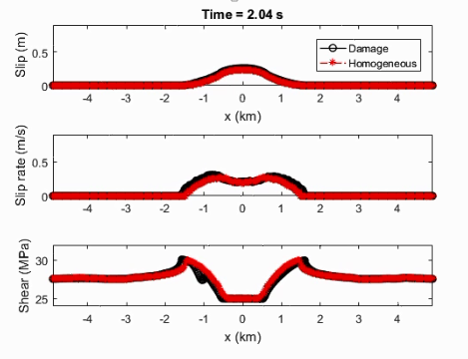
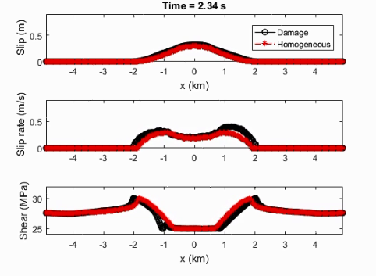
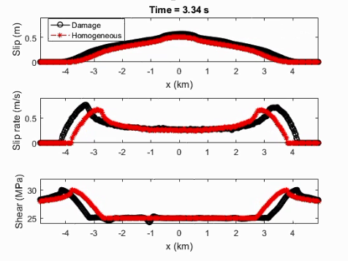
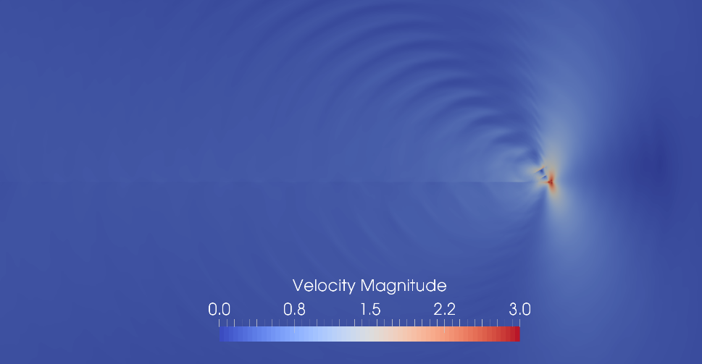
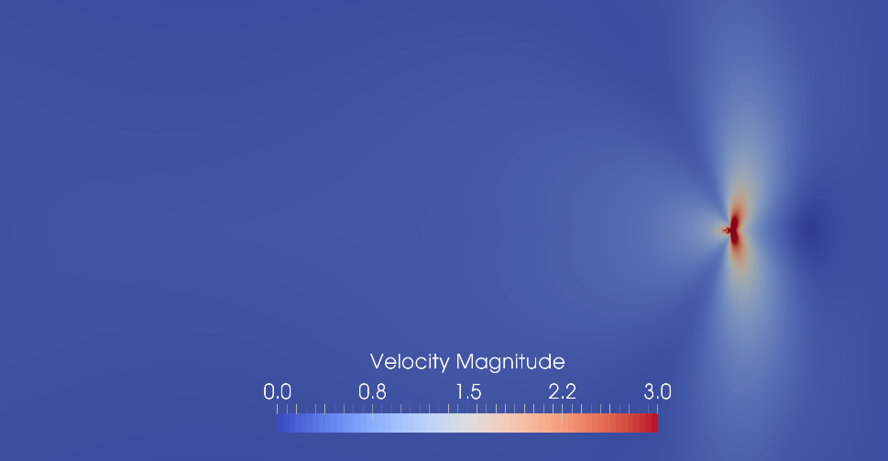
Modeling Dynamic Ruptures with High Resolution Fault Zone Physics Xiao Ma and Ahmed E. Elbanna SCEC Annual Meeting, Palm Spring, September 2018
MCS
laboratory
Poster #200
Introduction
Model Setup
Conclusions
Modeling Damage Zone with Fish bone structure
Modeling Damage zone with
random faults
The hybrid FEM-SBIE method enables modeling fault zone physics with high resolution.
The Fish bone structure acts as energy sink, slowing down the main rupture.
The Fish bone structure results in heterogeneous post-rupture stress on the main fault
The explicit modeling of the damage in fault zone shows that secondary branches could act as energy source (at least temporally) promoting the rupture.
The complex fault geometry results complex velocity field in the fault zone.
Earthquake ruptures are highly nonlinear phenomenon with spatio-temporal complexity on multiple scales.
SBIE
SBIE
Furthermore,
faults can be non-planar.
small-scale heterogeneities and/or material nonlinearity usually exist within the fault zone.
ABC
ABC
ABC
ABC
SBIE
SBIE
All faults are governed by Slip weakening friction.
The nucleation of the main fault is by overstressing a central patch.
The fundamental length scale is the characteristic length R [Uenishi and Rice, 2003] , $μ_{1}$ is the shear modulus,
$d_{c}$ is the slip weakening length. $τ_{s}$ is the static frictional stress. $τ_{d}$ is the dynamic frictional stress.
Fish Bone:
The length of secondary faults is R, their spacing is 0.5R. Their angle is 46 degree with respect to the horizontal axis , which is aligned with the optimal shear plane direction.
The initial stresses on the faults are resolved properly from the background stress field.
The half width of the virtual strip is 2R
Random Faults:
The secondary faults are 0.5R with random orientation.
The initial stresses on all the faults are resolved properly from the background stress.
The main fault rupture is nucleated after 2 seconds, to give time for the wave caused by the secondary faults to vanish.
The half width of the virtual strip is 2R
Lin and Yamashita (2013)
© Helmholtz Centre Potsdam
Results
Hybrid FEM-SBIE Method
Ongoing Work
Fish Bone Structure
Damage Zone with random faults
Material nonlinearity
Non-planar faults.
Cycle simulation with complex fault geometry and material nonlinearity
The interference patterns emerge from interaction with the branches
References
Ma. X, Hajarolasvadi, S., Albertini, G. Kammer. D, Elbanna. A, 2018, IJANMG (recommended for publication)
Day, S.M., Dalguer, L.A., Lapusta, N. & Liu, Y., 2005, J. Geophys. Res.
Hajarolasvadi, S. & Elbanna, A., 2017, Geophys. J. Int.
Lapusta, N., Rice, J. R., Ben-Zion, Y., Zheng, G., 2000, J. Geophys. Res.
Geubelle, P.H. & Rice, J.R., 1995, J. Mech. Phys. Solis.
Uenishi. K & Rice.J , 2003, J. Geophys. Res
Spectral Boundary
Integral
Finite Elements
Computationally
Efficient
Able to handle
nonlinearities/
heterogeneities
Fish Bone
Fish bone structure act as energy sink, slowing down the main fault rupture.
In Random fault zone case, secondary faults may also act as energy source (at least in transient sense) promoting the main fault rupture
Apply the recently develop Hybrid FEM-SBIE (Ma at el., 2018 ) method to model spatially complex fault zones (complex fault geometry, plasticity etc.) with high resolution.
Acknowledgements
Homogenous
Teng, Xiao and Elbanna

